Slide 1



STELLAR OBJECT CLASSIFICATION
Om Gharat
Batch: AND-JUN2024-DSAI-1
Room No: TR 2
Place: Mumbai

Slide 2
AGENDA
Introduction
Problem Statement
Goal
Dataset Overview
Exploratory Data Analysis
Data Cleaning & Preprocessing
Feature Engineering
Model Selection
Feature Extraction
Model Training
10. Evaluation & Metrics
11. Metrics Result
12. Conclusion: Ml Model Result

Slide 3
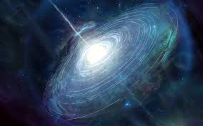
INTRODUCTION
Quasars: Quasars are extremely bright objects powered by supermassive black holes at the centers of distant galaxies. They release massive energy and are among the brightest objects in the universe.
Galaxies: Galaxies are vast systems of stars, gas, dust, and dark matter, held together by gravity. They come in various shapes and sizes, and are the primary structures in the universe.
A star is any massive self-luminous celestial body of gas that shines by radiation derived from its internal energy source.

Slide 4

PROBLEM STATEMENT
Develop comprehensive machine learning models to accurately classify celestial objects as stars, galaxies, or quasars. By utilizing these models, the institute aims to improve astronomical cataloging, research directions, and our understanding of the universe.

Slide 5
GOAL
A classification model robust enough to be integrated into astronomical monitoring systems, capable of automatically identifying stars, galaxies, and quasars with high accuracy, and that can serve as a foundation for the development of new astronomical studies.

Slide 6

DATASET OVERVIEW
The data consists of 100,000 observations of space taken by the SDSS (Sloan Digital Sky Survey). Every observation is described by 17 feature columns and 1 class column which identifies it to be either a star, galaxy or quasar.
obj_ID = Object Identifier, the unique value that identifies the object in the image catalog used by the CAS
alpha = Right Ascension angle (at J2000 epoch)
delta = Declination angle (at J2000 epoch)
u = Ultraviolet filter in the photometric system
g = Green filter in the photometric system
r = Red filter in the photometric system
i = Near Infrared filter in the photometric system
z = Infrared filter in the photometric system
run_ID = Run Number used to identify the specific scan
rereun_ID = Rerun Number to specify how the image was processed
cam_col = Camera column to identify the scanline within the run
field_ID = Field number to identify each field
spec_obj_ID = Unique ID used for optical spectroscopic objects (this means that 2 different observations with the same spec_obj_ID must share the output class)
class = object class (galaxy, star or quasar object)
redshift = redshift value based on the increase in wavelength
plate = plate ID, identifies each plate in SDSS
MJD = Modified Julian Date, used to indicate when a given piece of SDSS data was taken
fiber_ID = fiber ID that identifies the fiber that pointed the light at the focal plane in each observation

Slide 7
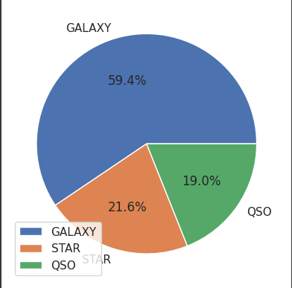
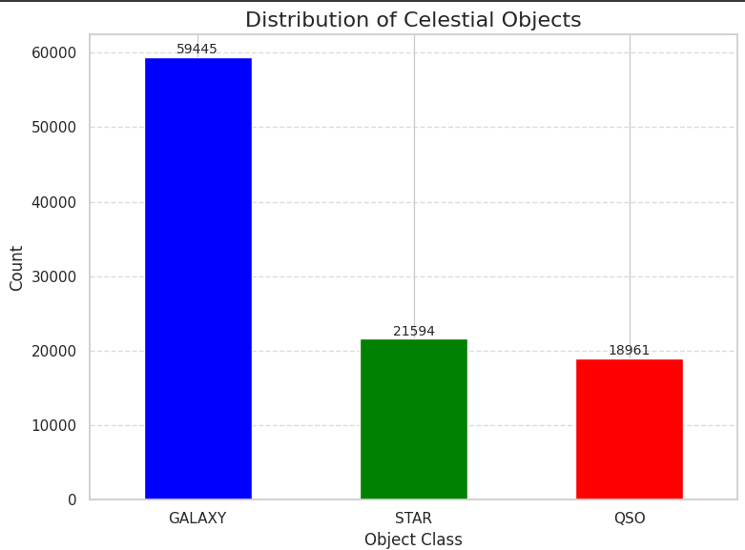
EXPLORATORY DATA ANALYSIS
Distribution Analysis: What is the distribution of stars, galaxies, and quasars in the dataset? How are they represented in terms of frequency and proportions?

Slide 8
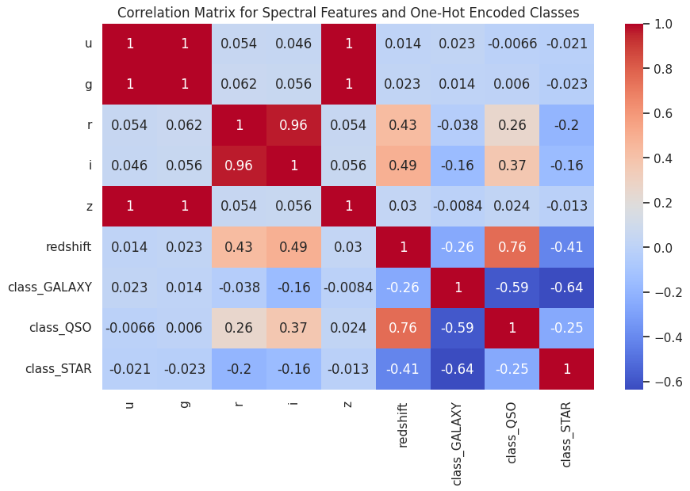
EXPLORATORY DATA ANALYSIS
Strongest Correlations: The r vs i correlation of 0.96 is the highest in the dataset, which suggests that these two spectral bands are closely related and likely represent similar emission characteristics of celestial objects.
Moderate Correlations: Several other correlations, like g vs r and g vs i, fall into the moderate range (0.5-0.6), indicating that while these features are related, they do not follow as closely as the red and infrared correlations.
Weakest Correlations: The u vs i correlation of 0.46 is one of the lower values, suggesting that the ultraviolet and infrared parts of the spectrum are less tightly linked compared to the red and infrared bands.

Slide 9
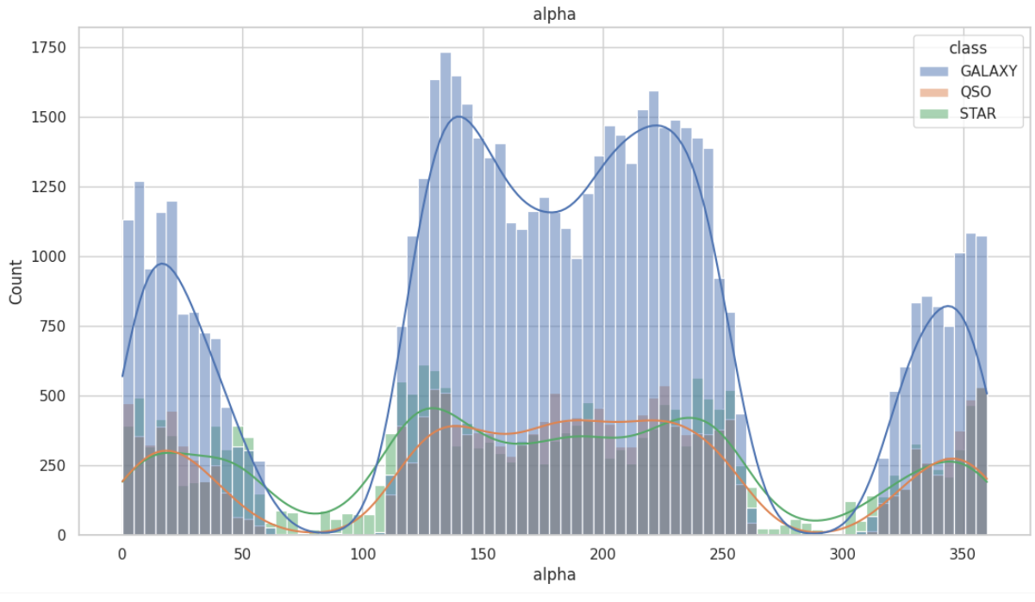
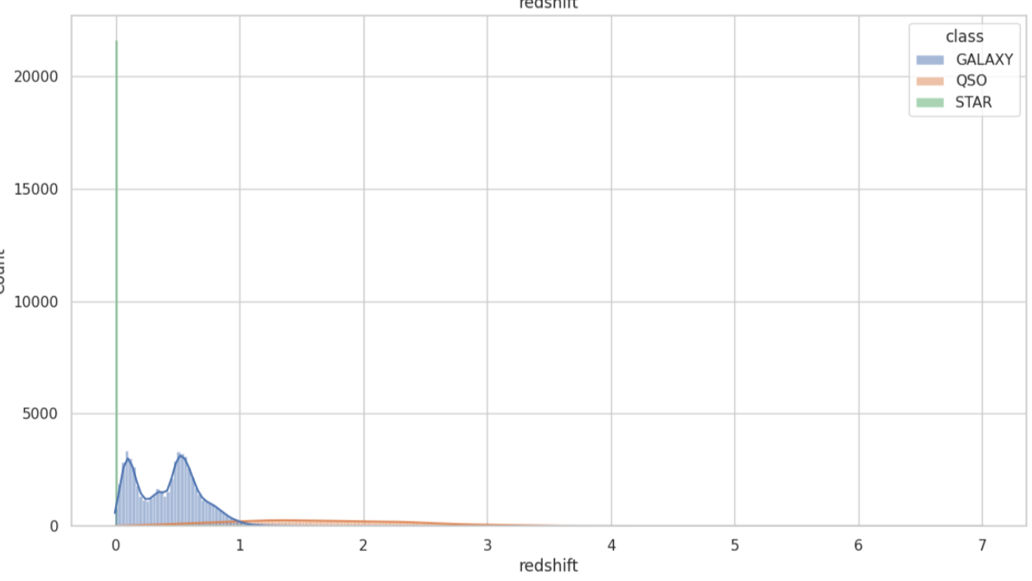
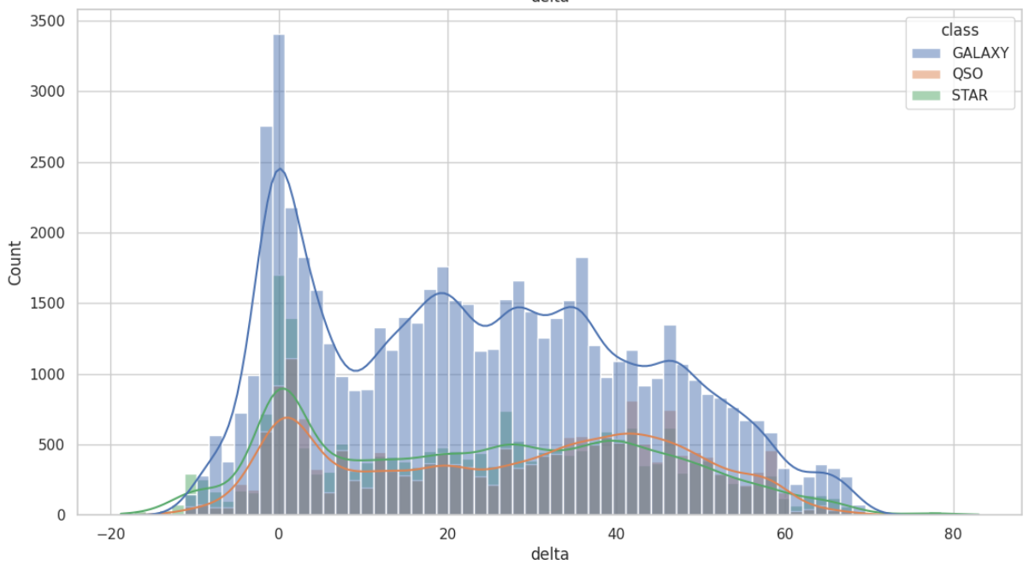
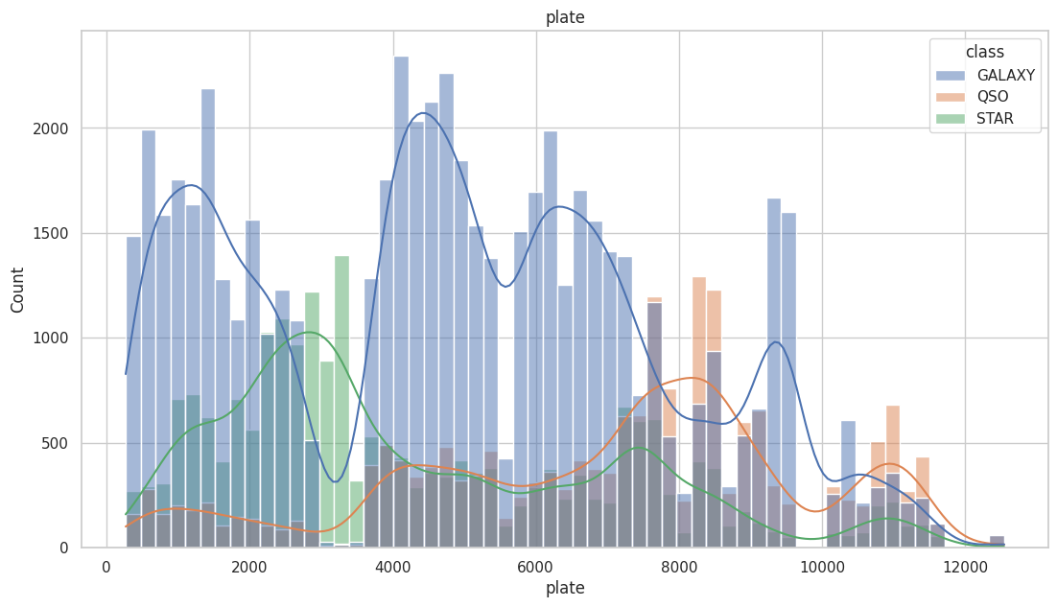
EXPLORATORY DATA ANALYSIS
Class Overlap: Are there regions in feature space where stars, galaxies, and quasars overlap significantly? How can this be resolved with additional features or classification techniques?

Slide 10
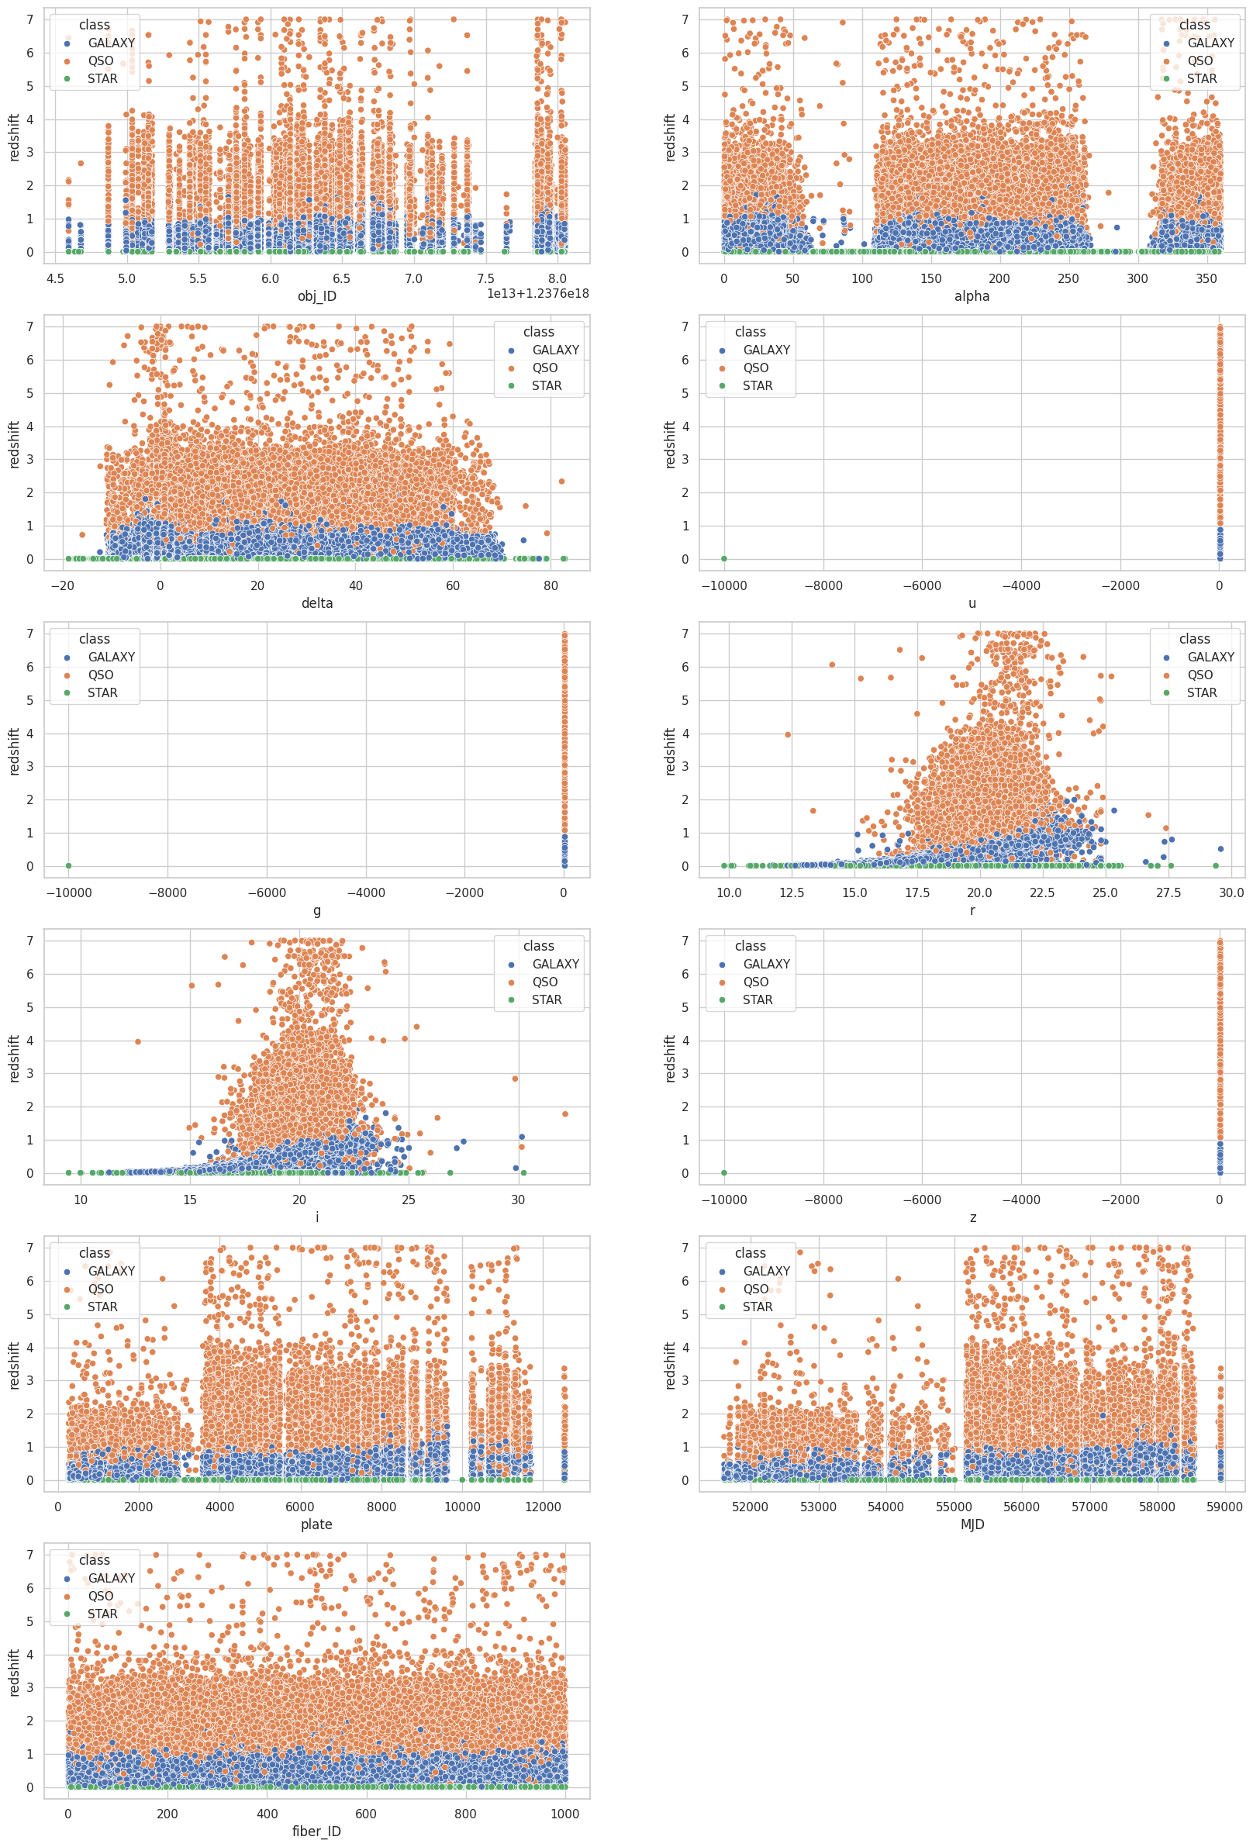
EXPLORATORY DATA ANALYSIS
In the dataset,. each subplot displays a scatter plot comparing a specific feature (like object ID, alpha, delta, or spectral measurements) against the redshift value. The points in each plot are colored according to the object's classification (star, galaxy, or quasar) to visually distinguish potential patterns. This visualization helps in understanding how these features might correlate with the redshift of celestial objects and aid in their classification. Essentially, the code is creating a visual exploration tool to investigate potential relationships between different properties of celestial objects and their redshift values.

Slide 11
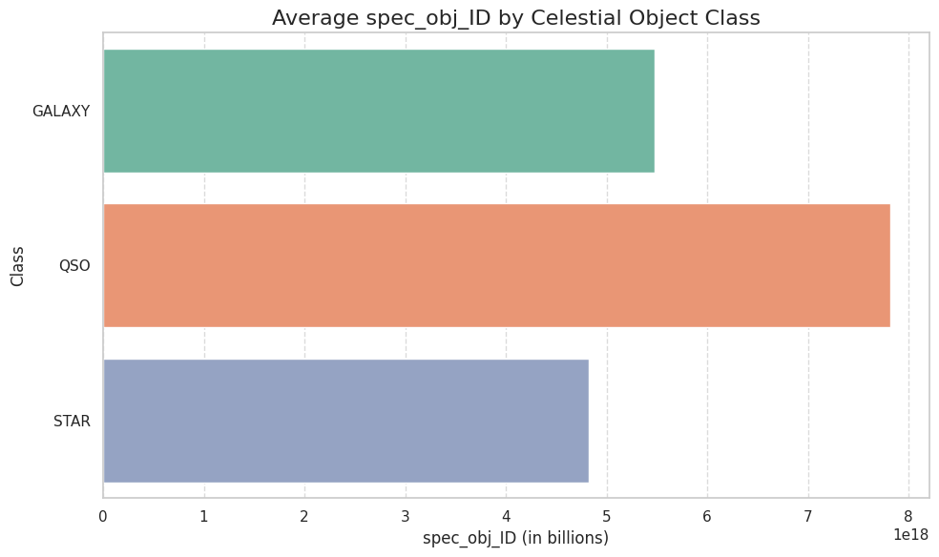
EXPLORATORY DATA ANALYSIS
It generates a bar plot visualizing the average spec_obj_ID for each celestial object class (star, galaxy, quasar). The plot is customized with labels, titles, gridlines, and color to enhance readability and interpretation.

Slide 12

DATA CLEANING & PREPROCESSING
REMOVE IRRELEVANT COLUMNS:
HANDLING MISSING VALUES:
DATA SPLITTING:
Split the data into training and testing sets (e.g., 80% training, 20% testing) to evaluate model performance.rs.
Drop ID columns (obj_ID, run_ID, rerun_ID, cam_col, field_ID, spec_obj_ID, plate, MJD, fiber_ID) as they don’t contribute to classification.
Check for missing values in relevant columns (alpha, delta, u, g, r, i, z, redshift).
Impute missing data if necessary (e.g., mean, median), or remove rows with missing values if imputation is not feasible.
CLASS LABEL CONVERSION:
FEATURE SELECTION:
Ensure the class column (galaxy, star, quasar) is labeled numerically:
Galaxy = 0, Star = 1, Quasar = 2 (if not already numerically labeled).
Retain only the key features: alpha, delta, u, g, r, i, z, redshift.
Analyze correlations between features to eliminate any highly correlated features that may add redundancy.

Slide 13
FEATURE ENGINEERING
Feature engineering is a crucial step in the data preparation process in data science and machine learning. It involves the creation or transformation of variables (also known as features) to improve the performance of machine learning models. Good feature engineering can increase model accuracy, reduce overfitting, and consequently generate more meaningful insights from the data. There are various feature engineering techniques, including creating new features from existing ones, data normalization, handling missing values, and converting categorical variables into numerical ones, among others. Each technique is applied according to the nature of the data and the requirements of the problem at hand.
Label Encoder assigns a unique value to each category present in the categorical variable. For example, if we have a variable called "Size" with categories "Small," "Medium," and "Large," the Label Encoder might assign the values 0, 1, and 2, respectively, to these categories. In this way, the categories are represented by integers, making them suitable for analysis by machine learning algorithms. It is important to mention that Label Encoder is more appropriate for ordinal categorical variables, where there is an intrinsic order between the categories. For nominal categorical variables, where there is no such order, other techniques such as One-Hot Encoding may be more suitable. These techniques allow the data to be properly processed by machine learning algorithms, contributing to the construction of more accurate and effective models.

Slide 14


MODEL SELECTION
Multiple models are evaluated, The selection is based on the log loss for training, testing, and validation errors. The best-performing model is chosen for further tuning.
1
2
3
K-Nearest Neighbors (KNN)
Logistic Regression
Decision Tree, Random Forest
4
5
6
Navie Bayes
Gradient Boosting, and XGBoost

Slide 15
Logistic Regression: A linear model used for solving binary classification problems.
Naive Bayes: A probabilistic model based on Bayes' theorem, suitable for classification problems with independent features.
Decision Tree: A model that uses a tree structure to represent hierarchical decision rules.
Random Forest: An ensemble learning technique that combines multiple decision trees to improve model accuracy and robustness.
AdaBoost: Another ensemble learning algorithm that iteratively adjusts the weights of observations to focus on the most challenging cases.
Gradient Boosting: An ensemble learning technique that builds decision trees sequentially, optimizing a specific loss criterion.
XGBoost: An efficient implementation of gradient boosting, known for its speed and superior performance.
KNN: KNN is based on the assumption that similar items are close to each other in a feature space.

Slide 16
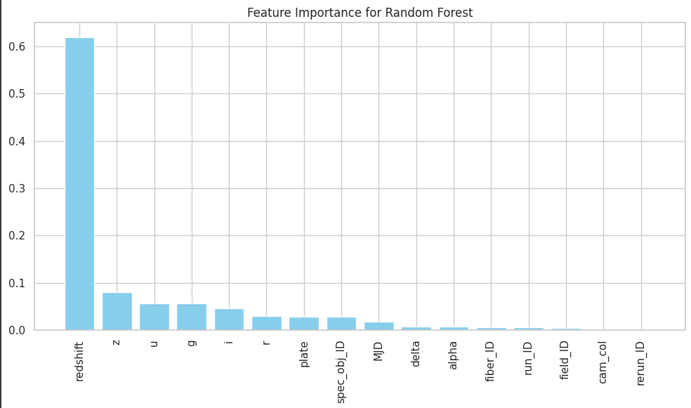
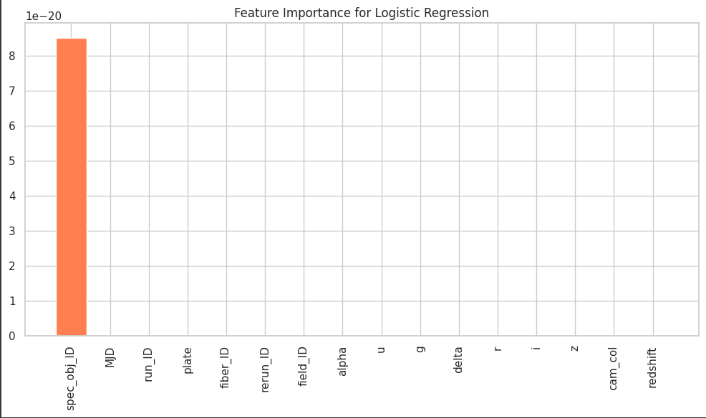
FEATURE EXTRACTION
Dominance of Redshift: Across Random Forest and Decision Tree, redshift consistently stands out as the most influential feature. This indicates that redshift has a significant impact on object classification in the dataset.
Model Behavior:
Ensemble Methods (Random Forest): They show a more balanced usage of features compared to simpler models like Decision Tree, although redshift still dominates.
Logistic Regression: This model seems to fail in capturing the important features, as reflected by the extremely low importance scores for all features.

Slide 17
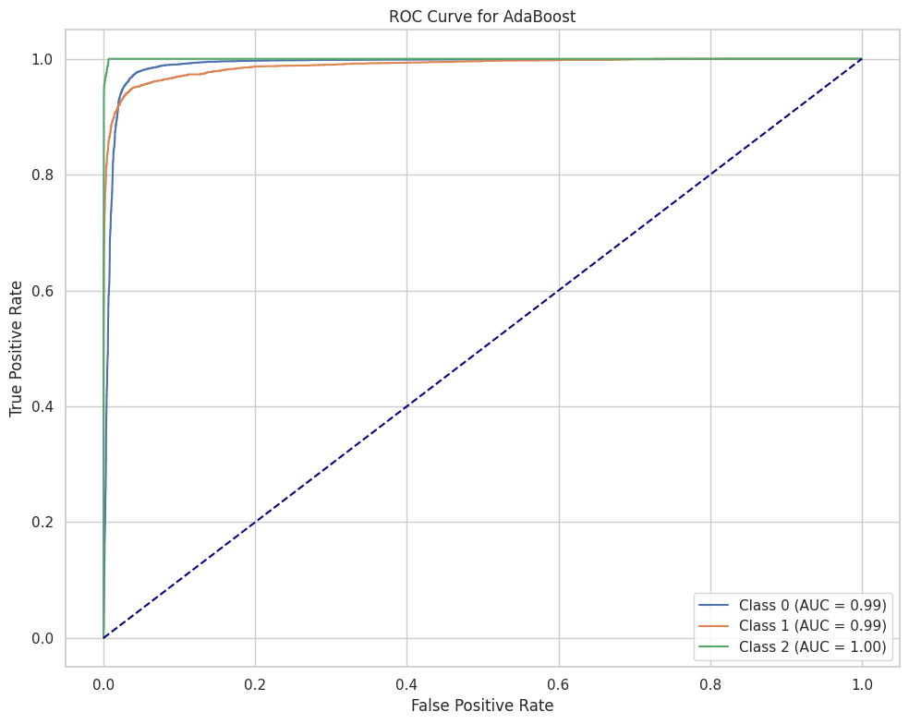
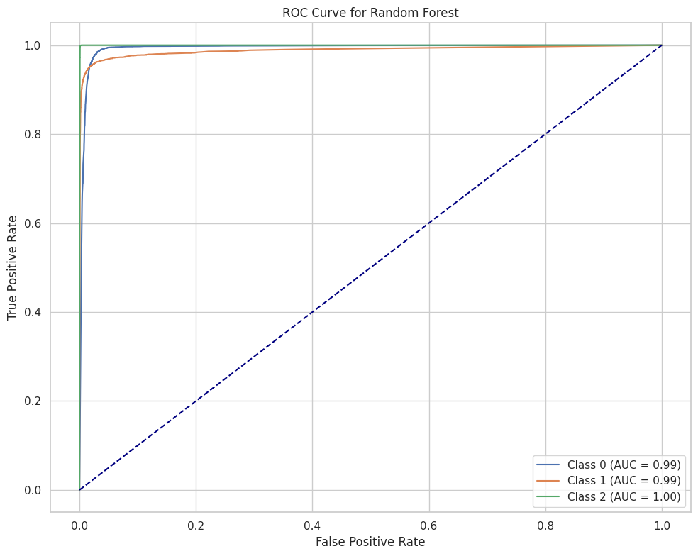
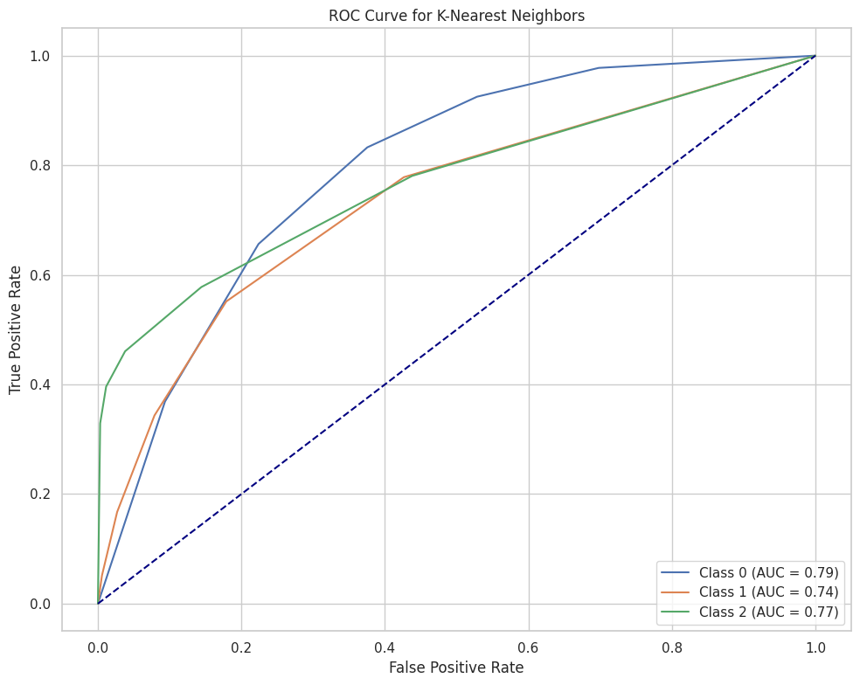
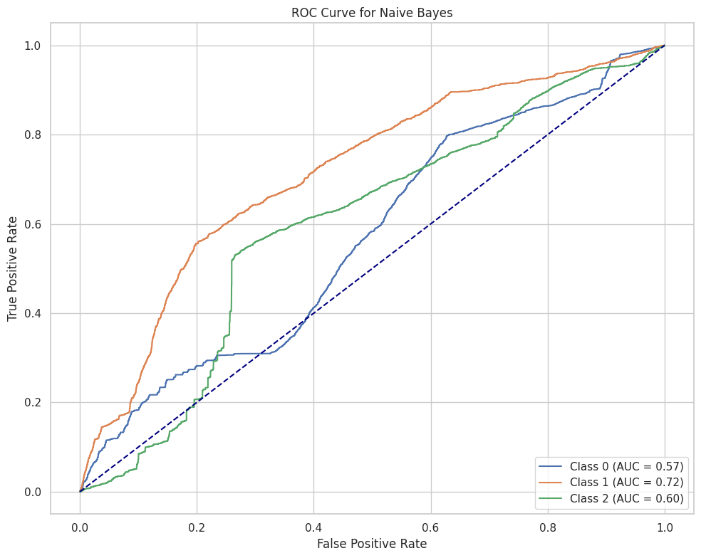
EVALUATION & METRICS
Best Performing Models: Random Forest, AdaBoost, XGBoost and Gradient Boosting all perform exceptionally well, with AUC values close to 1 for all classes. These models would be considered the best choices based on the ROC analysis.
Moderate Performing Models: KNN shows reasonable performance with AUC values around 0.74-0.79, but it's not as strong as the ensemble methods.
Poor Performing Models: Logistic Regression and Naive Bayes perform the worst, especially Logistic Regression, which struggles to distinguish between the classes with AUC values as low as 0.28 for class 1.

Slide 18
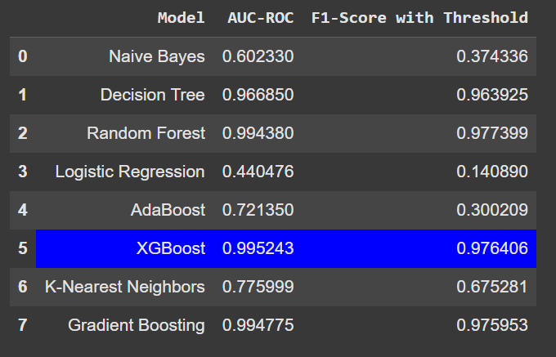
METRICS RESULT
Best Performer: XGBoost is the top model in both AUC-ROC and F1-score, making it the most effective classifier for this task. Its near-perfect AUC-ROC indicates excellent class separation, and its high F1-score shows a strong balance of precision and recall.
Other Strong Performers: Random Forest, and Gradient Boosting also perform very well, with high AUC-ROC and F1-scores. These models are all suitable for this classification task and provide reliable results.
Moderate Performers: AdaBoost and KNN provide decent results but are not as effective as the top ensemble models.
Poor Performers: Naive Bayes and Logistic Regression are the weakest models, with low AUC-ROC and F1-scores, indicating they struggle with this classification problem.

Slide 19
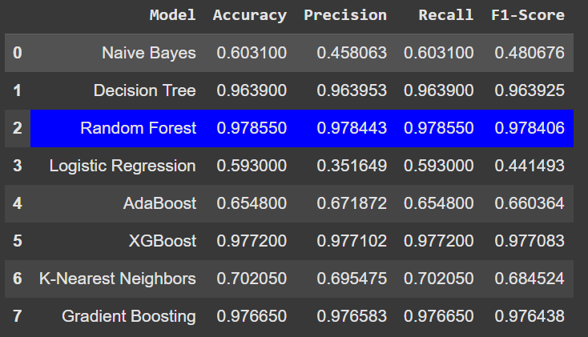
CONCLUSION:ML MODEL RESULT
Top Performers: Random Forest and XGBoost are the top models in terms of overall performance (high accuracy, precision, recall, and F1-score). Random Forest has the slight edge with the best balance across all metrics.
Moderate Performers: Decision Tree and Gradient Boosting are also strong models but slightly behind the top three. AdaBoost and KNN offer moderate performance but are not on par with the stronger models.
Poor Performers: Naive Bayes and Logistic Regression are the worst-performing models in this comparison, struggling with low precision and F1-scores.
Recommendation: For the best results, you should consider using Random Forest or XGBoost based on the task at hand. These models have proven to perform the best, achieving the highest scores in almost every category.

Slide 20

THANK
YOU

